Slide 1


Technical Webinar for ICLEI and WWF Offices
Notes:
Through the Earth Hour City Challenge WWF aims to identify and highlight action of cities that are prepared to become leaders in the global transformation towards a one planet economy.

Slide 2
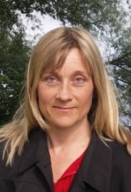
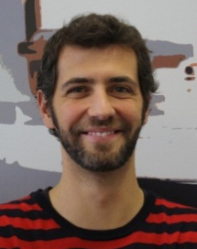

Technical webinar for WWF and ICLEI Offices
Presenters:
Carina Borgstrom Hansson, PhD
WWF Earth Hour City Challenge team
Lucas de Moncuit,
Cities Climate Center
ICLEI-Local Governments for Sustainability

Slide 3
Agenda
Practical instructions for webinar participation
ICLEI and WWF’s roles
The Earth Hour City Challenge (EHCC): background, purpose and evaluation procedure
How to report for EHCC on cCCR: technical guidance
Questions and answers
Next steps and conclusion

Slide 4
ICLEI and WWF’s roles according to the international MoU
WWF owns and manages the EHCC campaign and ICLEI owns and manages the cCCR platform
WWF leads on communications and outreach and brings criteria for how to prioritize which cities should be particularly encouraged and supported to enter the EHCC
ICLEI leads on the technical support and where possible assists cities that enter the EHCC through its other projects and programmes.
The international MOU does not overarch existing and future bilateral agreements of respective ICLEI and WWF offices at the country level
Notes:
WWF owns and manages the EHCC campaign and ICLEI owns and manages the cCCR platform
WWF leads on communications and outreach and brings criteria for how to prioritize which cities should be particularly encouraged and supported to enter the EHCC
ICLEI leads on the technical support and creating synergies with local connections to cities that chose to enter the EHCC
The international MOU does not overarch existing and future bilateral agreements of respective ICLEI and WWF offices at the country level. ICLEI and WWF welcome opportunities to specify the collaboration at the country level on communication and technical support to EHCC candidate cities through existing and future bilateral agreements of respective ICLEI and WWF offices.

Slide 5
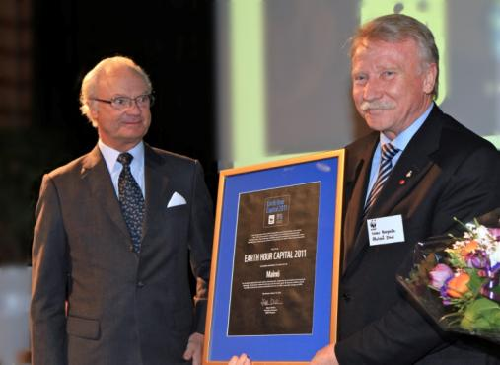
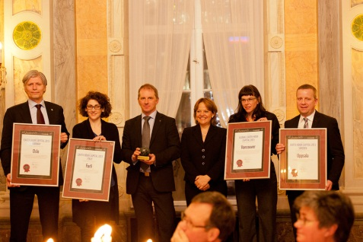
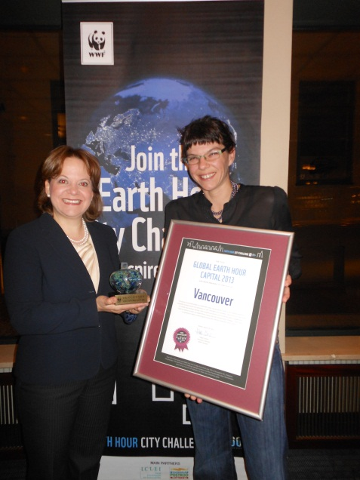
Background Earth Hour City Challenge 2010-2013
First National EHCC Pilot 2010-2011
Challenging cities to report their actions towards a 100% renewable, One Planet Future
Teamed up with ICLEI
Evaluation by high level jury including experts from ICLEI, C40, CDP, UNFCCC, etc
First international pilot launched in 6 countries
Awards to Oslo, Forli, Uppsala, San Francisco, Delhi, Vancouver
Notes:
The city challenge was first tested in Sweden where Malmö received the first EH Capital Award ever mainly for its strong commitments and actions to make the whole geographic area to run on 100% renewable energy by 2030. As WWF wanted to develop this initiative for a global scope we teamed up with ICLEI and selected he cCCR as the reporting platform. We also recruited a high level international jury of experts for the initiative.
So last year the first international pilot was launched in six countries resulting in 66 cities receiving candidate status. And in March finally Oslo in Norway, Forli in Italy and Uppsala in Sweden, New Delhi in India and San Francisco in US were awarded as national capitals. And the global EH capital award went to Vancouver, Canada for its numerous commitments and actions indicating true global leadership on climate smart, sustainable urban development even in the context of low national ambitions

Slide 6
Purpose of the Earth Hour City Challenge 2013-2014
Mobilize action and support from cities in the global transition towards a climate friendly, one planet future with a focus on shifting from fossil to renewable energy solutions
Cities/local authorities report their ambitious, holistic, inspiring and credible plans for:
dramatically increasing the use of renewable energy solutions in the next few decades
low-carbon development including emissions mitigation, energy efficiency and other sustainability criteria
This year the evaluation will particularly consider how actions and commitments of the candidate cities contribute to moving investment from fossil toward renewable energy solutions
The selection of the Earth Hour Capital will take into consideration resources committed in relation to the size of the sustainability challenge and the capabilities of the city/country

Slide 7
Evaluation procedure
All candidate cities must report the relevant info on the cCCR platform by October 13 2013?
Minimum requirements to be a candidate city are at least one commitment and one reported action to mitigate carbon emissions
All candidate cities will be prescreened by Accenture who will quality control the whole evaluation procedure
Accenture in consultation with local WWF experts shortlists up to three candidate cities as finalists in each country
An international jury of experts then selects a national Earth Hour Capital for each country and finally one Global Earth Hour Capital
Local context, eg national/regional support for urban sustainability, resources available, local challenges (urban poverty), city size will be taken into account when selecting the Earth Hour Capitals

Slide 8

Overview of selection procedure
EHCC capital
3. Finalists in the limelight
4. Jury decisions
January – first half of February 2014
Actions of top 1-3 cities in each country are promoted in public media campaigns. Finalist cities may be invited to submit complementary information based on questions from the jury
What cities need to do
What WWF and partners will do
Jury #2
January - February 2014
Meeting 1: An expert jury discuss city actions and select the most ambitious city in each country
Meeting 2: The jury makes deeper level scrutiny of city strategies and selects the Global EHCC capital
Jury #1
Pre-screening
May - October 2013
Cities submit data on emissions and actions on cCCR platform at
http://carbonn.org/login/ehcc/
1. Submit data
2. Pre-screening
November-December 2013
Data is analyzed by Accenture & top 1-3 cities with most complete data and promising actions are shortlisted
Local WWF offices are consulted in nominating top 1-3 cities from shortlist
Submit city data

Slide 9
Five areas of assessment
The jury is looking for cities that are:
Moving toward a low carbon economy and strongly promoting the use of renewable energy solutions
Taking ambitious and strategic actions to meet commitments
Integrating actions into coherent strategies for sustainability
Innovating and thinking outside the box
Significant leadership and credibility with respect to local context
Notes:
Moving toward a low carbon economy and strongly promoting the use of renewable energy solutions. The reported actions, commitments and possible inventories will be evaluated to assess to what extent the cities are strategically shifting from a fossil fuel based to a renewable and energy efficient economy.
Taking ambitious and strategic actions to meet commitments. City actions will be assessed for level of ambition and ability to target the areas where change is most needed in order to meet their mitigation targets while also meeting human needs in a sustainable way - particularly in housing, energy, mobility and food.
Integrating actions into coherent strategies for sustainability. Action and engagement information will be analyzed to find cities with the most comprehensive strategies to meet their climate targets, including multiple challenges such as adaptation needs as well as involving the public.
Innovating and thinking outside the box. Where relevant, the jury will look for actions and strategies that include transboundary approaches, eg promoting low footprint lifestyles to also reduce transboundary emissions caused by local consumption, as well as making use of their networking power to support the scaling up of climate smart urban solutions also beyond their own boundaries.
Significant leadership and credibility with respect to local context. The degree of leadership and credibility will be assessed in terms of the level of commitments and actions in relation to the size of the challenges and the availability of resources and mandate to act.
My idea is that this should be an updated and more clear explanation of the five areas of assessment slide for the webinar. Any suggestions for additional clarification/rephrasing here?

Slide 10
Why should cities participate?
Increase awareness among the public, policy makers, and companies for the progressive work you are doing or planning to do
Develop reporting in a transparent and accountable way of your climate related data and plans on an internationally recognized climate reporting platform for cities
Finalist cities will receive qualitative feedback on their development plans from international jury of experts
Increase interest from the media at local, national and global levels
Put your city on the map as a national or global Earth Hour Capital
Share expertise with and learn from other cities and partners
Place collaborative pressure on national governments and finance institutions to support local climate action
Notes:
10

Slide 11
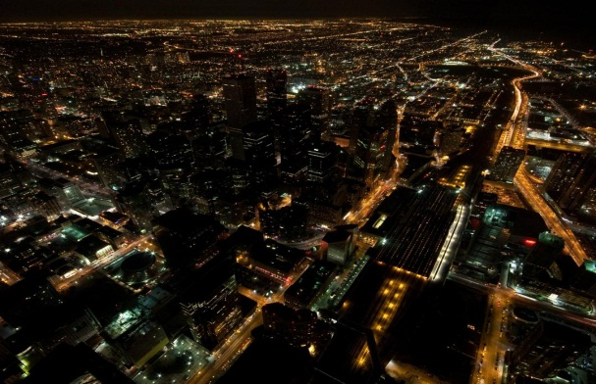

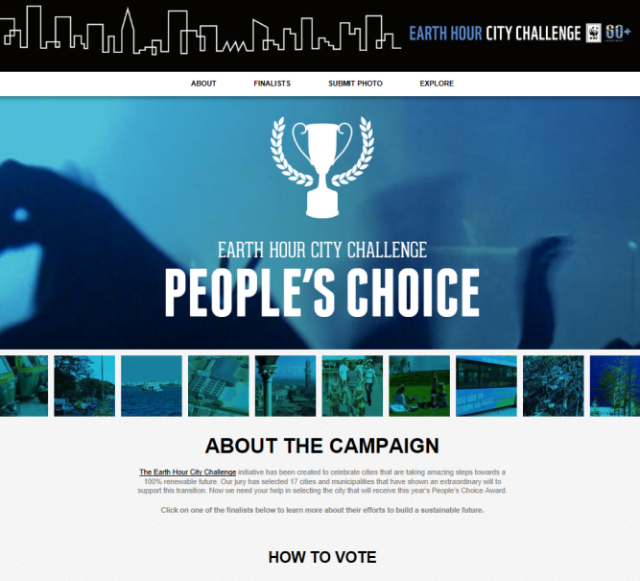
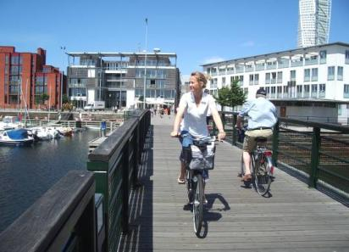
Powerful communications opportunities for finalist cities
Press releases (e.g. launch, finalists, global EH Capital, People’s Choice, Earth Hour)
Films highlighting best practice examples of urban sustainable development from finalist cities
EHCC global conference and award ceremony & national launch events
People’s Choice campaign
Seize Your Power Campaign

Slide 12


ICLEI and the carbonn Cities Climate Registry
Global reporting platform of local climate actions
Goal is to showcase actions taken by local government and promote information sharing
Future integration with other ICLEI initiatives
(Urban-LEDS, HEAT+, Global Protocol for Community-Scale GHG emissions
Network of local governments dedicated to the promotion of sustainable development
Promote the adoption of low emission development strategies by cities worldwide
Advocate for local climate action in global climate negotiations
Notes:
ICLEI is a woldwide network of local governments and the particularity of our members is that they have all committed to promoting sustainable development practices at the local level. ICLEI runs a number of activities and projects and we organize various conferences and summits (Resilient Cities, Mayors Adaptation Forum, World Mayors Summit on climate Change,…)
In the context of climate change, ICLEI, in addition to running projects and activities, also has the official role of observer in the international climate negotiations where we advocate for local climate actions on behalf or our members. In addition, we also host the secretariat of the World Mayor Council on Climate Change.
1000 members worldwide, ranging from mega-cities with tens of millions of inhabitants to towns so we are indireclty representing hundreds of millions of people which makes us an important partner in the global climate debate. The carbonn Cities Climate Registry is also an important tool in this regard. Every year we present the annual report of the registry to the United Nations Climate Conferences. In 2011 in Durban and in 2012 Doha and this year it will be presented again at COP19 in Warsaw.
The platform was launched at the World Mayors Summit on Climate in Mexico City in late 2010 toghether with the Mexico City Pact.
Very ambitious initiative. Thanks to the collaboration with the WWF but also to the possibility of integrating it with other ICLEI projects and initiatives, the decision was taken to improve it and it will be relauched very soon with a new design and a new structure.
The integration of the registry with other projects and initiatives include the vision to connect it with Urban-LEDS for example at the level of workpackage 5 which aims to develop a „solution gateway“ and a „pool of expert“ which cities would have access to. Integration with HEAT plus is also envisaged. It is a GHG emissions calculator developed by our colleague from the South Asia Secretaria. Plus the registry could connect with the Global Protocol for Community Scale GHG.

Slide 13
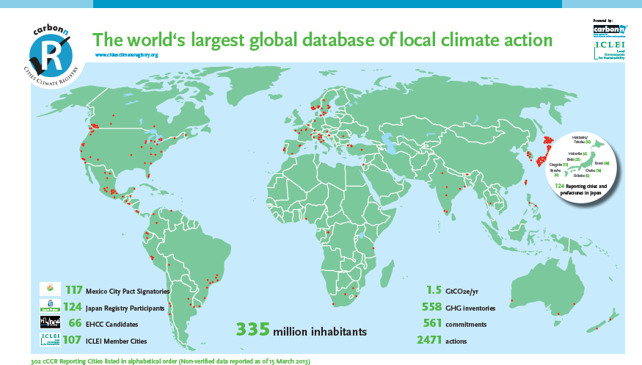
carbonn Cities Climate Registry (cCCR)
Notes:
This is quite uptodate information. We have 305 reporting cities from most parts of the world. The growth rate is steady but as already said we haven t been promoting it very actively except in Japan so the potential for growth is still huge.
If we now have a look at the type of actions present in the database.

Slide 14

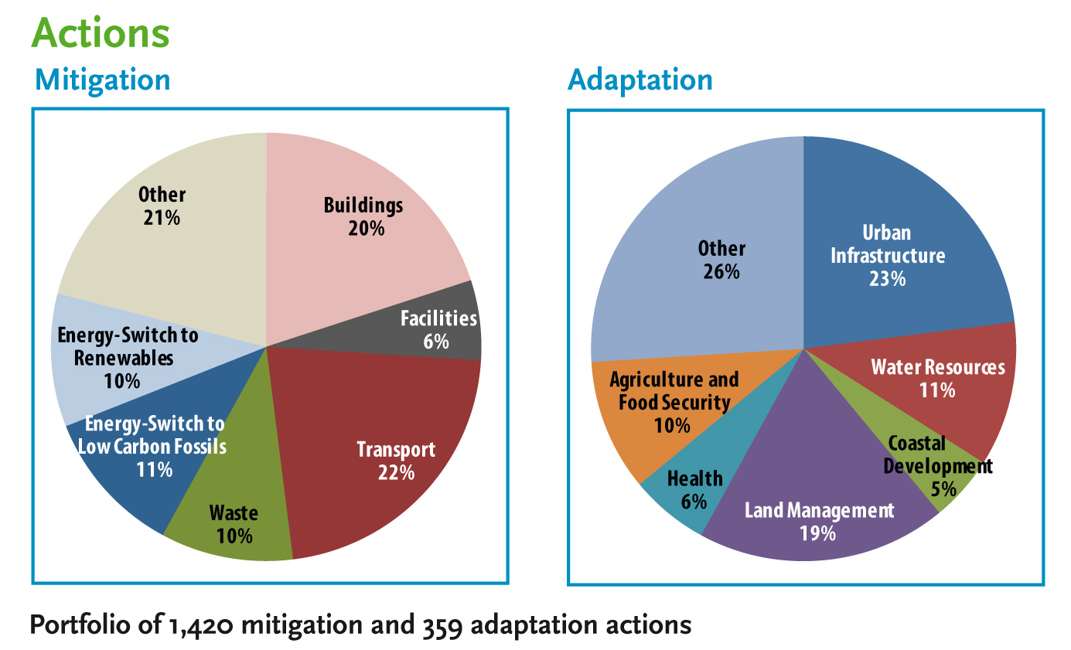
cCCR (iv)
World´s largest global database of local climate action (analysis based on reported information as of November 2012)
Notes:
90% of all entries for local climate action focus on sector-specific (mitigation/ adaptation) measures, whereas 10% represent holistic action plans.
More than 50% of mitigation actions are indicated with concrete co-benefits for local sustainable development and 61 cities of developing countries that represent 20% of all cCCR reporting cities contribute 47% of all reported adaptation actions.

Slide 15
Contribution of EHCC to cCCR
66 EHCC Candidate Cities from 6 pilot countries, constitute 21% of reporting cities,
193 commitments (34%)
230 GHG inventories (42%)
1232 actions (49%)
Notes:
Only 21% of reporting cities reported 49% of all the actions currently in the database but this is not suprising with cities like Vancouver reporting alone 76 actions last year!
Let´s move on to the next slide to have look at the platform from a structure point of view.

Slide 16
Structure of the carbonn Cities Climate registry
cCCR
City info
Performances
Commitments
Actions
City report
Notes:
The registry is made up of four sections. The first one contains the city information, the second one the information on performances, that is the inventories, the third one is about commitments and the last one focuses on climate actions. The data contained in those four segments, are then used to produced the city reports which I will also introduce you later on.
As the new version is not ready yet I will use diagramm. At the end of the presentation I will take you on a quick online tour of the current registry so you can appreciate the changes when they come into effect.
In order to facilitate the participation, EHCC participants are only required to enter information for at least one commitment and one action. Performances are not compulsory as developing Greenhouse gase inventories can be complex and costly processes that some cities haven t been able to implement, especially in some developing countries. Along the same line, our goal is to make the reporting of action and commitment as light as possible so we decided that for EHCC participants only required fields would be put forward.
Participating cities will have the choice to enter the data either using the online data entry form (the website) or the offline data entry form which is basically an excel spreadsheet with macros.
For European cities, the possibility to upload Covenant of Mayor GHG inventory sheet will be allowed.
The final version of the registry might differ from the one presented here as there might be some last minute changes.

Slide 17
City info
City name
Population
Community type
City Municipality
County
District Municipality
Metropolitan Municipality
State, Prefecture
Town, village
Affiliations
ICLEI member
National initiavites
Regional initiatives
Global initiatives
Population forecast
City budget
Region
Africa
Asia
Europe
North America
Latin America
Oceania
Background info (optional)
Number of passenger cars registered
Capacity of public transport (commuters/day)
Amount of solid wastes generated ton/day
Area
Geographic location
Latitude and longitude
Geography
Coastal
Dryland
Lowland
Highland
Mega Deltas
Small Island
Main Economic Sector
Industry and manufacture
Services
Agriculture and fishing
Notes:
Focus on mitigation actions
The final version of the registry might differ from the one presented here as there might be some last minute changes.

Slide 18
Commitments
Boundary
Community
Government
Total Final Energy consumption (Mwh)
Calculation year
Fossil fuels - solid (coal etc)
Fossil fuels – liquid (oil etc)
Fossil Fuels – gas (natural gas etc)
Renewables (biofuels, biomass, solar, thermal, geothermal)
Electricity (grid and off-grid)
Heat
% of Renewable Energy in Total Final Energy consumption
Target value %
Type
Carbon intensity (CI)
CO2
CO2e
Renewable Energy
Energy Efficiency
Target Year
Base Year
Units
tCO2emissions per unit of GDP
tCO2 emissions per capita
MJ per unit of GDP
MJ per capita
Adoption Year
Notes:
Focus on mitigation actions
The final version of the registry might differ from the one presented here as there might be some last minute changes.

Slide 19
Performance
Boundary
Government
Community
Municipal Adminstration Information as of inventory year
Number of Employees*
Budget of local government for inventory year (USD)*
Municipal Administration Energy Consumption (MJ)*
Emission sectors (government)
Buildings
Facilities
Transport
Waste
Other Emissions
Community information as of inventory year
Population
Community GDP
Emission sectors (community)
Residential
Commercial
Industrial
Transport
Waste
Other emissions
Inventory Year
CoM and GPC accepted
Technical details
Tool used
Name experts
Inventory verified?
Document Upload
Confidential GHG inventory
Notes:
Focus on mitigation actions
The final version of the registry might differ from the one presented here as there might be some last minute changes.

Slide 20
Action
ACTION TITLE
Types
Policy-Strategies-Action Plans
Regulatory
Technical-Technological
Fiscal-Financial-Procurement
Organizational-Governance
Education-Awareness Raising
Assessment-Research
Public Participation- Stakeholder engagement
Boundary
Community
Government
Focus
Adaptation
Mitigation
Methods
Renewable Energy shift
Low carbon energy shift
Management/Efficiency
Achievements
tCO2
Mwh
Sectors
Buildings
Facilities
Transport
Waste
Agriculture
Other
Finance
Partnership
Budget
Co-benefits
Improving urban air quality
Improving urban livelihoods
Securing safe and resilient energy supply
Increasing access to energy
Supporting green urban economy
Promote gender equality and empowering women
Preserving ecosystems
Improving public health
Improving social housing (incl. slum upgrading)
Improving access to clean water
None
Summary
Who
When
What
How
How much
Status
Completed
in progress
looking for funding
Notes:
Focus on mitigation actions
The final version of the registry might differ from the one presented here as there might be some last minute changes.

Slide 21
Example 1
Solar Panels on community buildings
Types
Policy-Strategies-Action Plans
Regulatory
Technical-Technological
Fiscal-Financial-Procurement
Organizational-Governance
Education-Awareness Raising
Assessment-Research
Public Participation- Stakeholder engagement
Boundary
Community
Government
Focus
Adaptation
Mitigation
Methods
Renewable Energy shift
Low carbon energy shift
Management/Efficiency
Achievements
10.000 tCO2e/year
Sectors
Buildings
Facilities
Transport
Waste
Agriculture
Other
Finance
1,500,000 USD
Co-benefits
Improving urban air quality
Improving urban livelihoods
Securing safe and resilient energy supply
Increasing access to energy
Supporting green urban economy
Promote gender equality and empowering women
Preserving ecosystems
Improving public health
Improving social housing (incl. slum upgrading)
Improving access to clean water
None
Summary
Planning and investigation is going on to install 10,000 m2 of solar cells to produce electricity. The city wants to create the solar densest neighborhood in the country.
Status
Completed
in progress
looking for funding
Notes:
Focus on mitigation actions
The final version of the registry might differ from the one presented here as there might be some last minute changes.

Slide 22
Example 2
Clean Power Action Plan
Types
Policy-Strategies-Action Plans
Regulatory
Technical-Technological
Fiscal-Financial-Procurement
Organizational-Governance
Education-Awareness Raising
Assessment-Research
Public Participation- Stakeholder engagement
Boundary
Community
Government
Focus
Adaptation
Mitigation
Methods
Renewable Energy shift
Low carbon energy shift
Management/Efficiency
Achievements
1,000,000 MtCO2
Sectors
Buildings
Facilities
Transport
Waste
Agriculture
Other
Finance
N/A
Co-benefits
Improving urban air quality
Improving urban livelihoods
Securing safe and resilient energy supply
Increasing access to energy
Supporting green urban economy
Promote gender equality and empowering women
Preserving ecosystems
Improving public health
Improving social housing (incl. slum upgrading)
Improving access to clean water
None
Summary
Goal aims to have the city producing and sourcing 100% of its electricity from clean resources in the next two decades.
Status
Completed
in progress
looking for funding
Notes:
Focus on mitigation actions
The final version of the registry might differ from the one presented here as there might be some last minute changes.

Slide 23
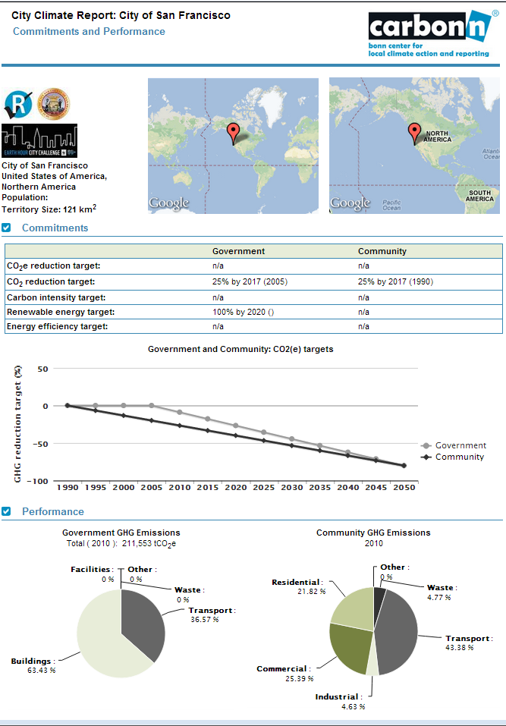
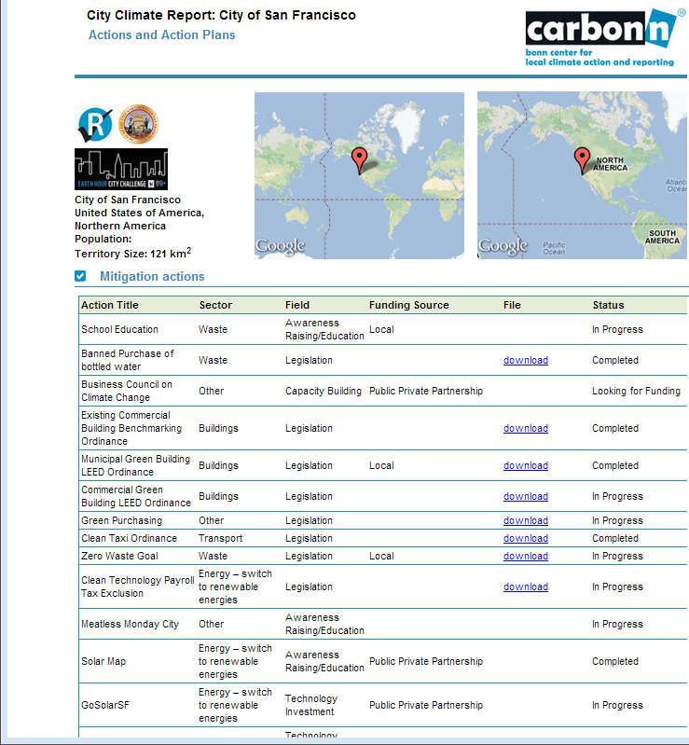
Example of a City report
Notes:
Visible to any registered users

Slide 24
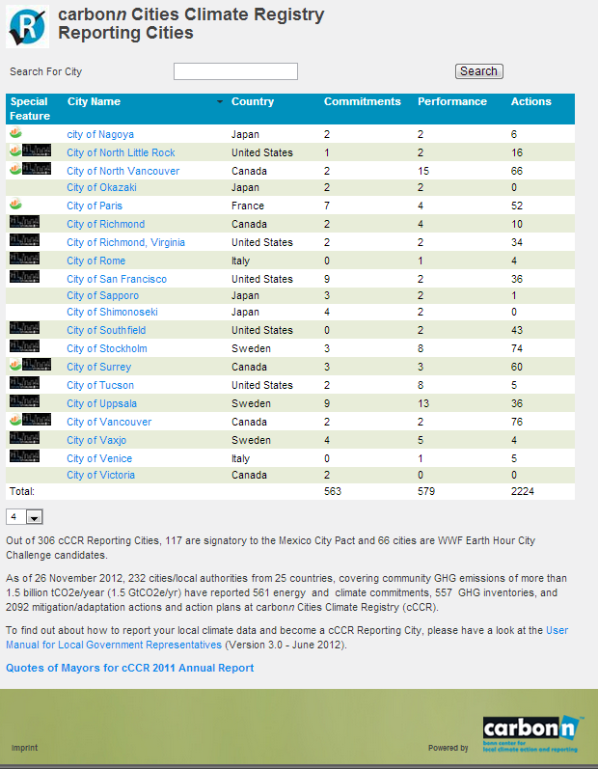
carbonn Cities Climate Registry (cCCR)
as the reporting platform of the EHCC 2012
http://carbonn.org/login/ehcc/
Notes:
Once a city registers on the cCCR it’s name appears on the website and it can be identified as EHCC canditate thanks to the EHCC logo placed next to the city name.

Slide 25
Confidentiality
Use of data by the cCCR
Use of data for the purpose of EHCC
No ranking involved in EHCC

Slide 26
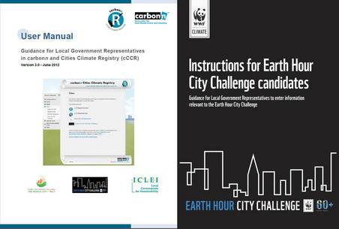
Guidance Documents for Reporting Process
Notes:
Technical instruction on how to report can be found in the User Manual (prepared by ICLEI) and in the Instructions for EHCC candidates prepared by WWF.
Links to updated versions will be made available from the website. Translated documents will be provided.
If you have translation capacity for those documents or for the website don’t hesitate to let us know!

Slide 27
Tips for reporting
Demonstrate what your city has accomplished the latest five years but also make sure to report actions in progress and looking for funding!
Prioritization:
At least 1 mitigation action and 1 commitment is required
Commitment to increase share of renewable energy is awarded in particular
For cities aiming for capital awards, reporting also at least one GHG inventory is required. Also tracking evolution in time by reporting more than one year is encouraged
Community level actions are strongly encouraged
Report expected achievements of all actions where this is possible (in terms of GHG emission reduction, increased RE energy share or reduced overall energy demand)
Actions supporting the shift toward renewable energy are particularly encouraged (eg through investments, procurement or bylaws)
Provide summaries of all actions
Uploading supporting documents is encouraged

Slide 28
Questions and answers

Slide 29
Next steps and conclusion
Press Release on 30 april
Press Conference to be confirmed Public webinars on 8 May Time: 10:00 AM - 11:00 AM CEST
https://www3.gotomeeting.com/register/260538294
Time: 5:00 PM - 6:00 PM CEST (GMT+1) https://www3.gotomeeting.com/register/406166134
Carbonn@ICLEI.org / lucas.de.moncuit@iclei.org

Slide 30
Thank you
www.panda.org
© 2010, WWF. All photographs used in this presentation are copyright protected and courtesy of the WWF-Canon Global Photo Network and the respective photographers.

Slide 31

Presentation title can go here
Secondary text can run underneath
WWF IN SHORT
+100
+5000
WWF is in over
100 countries, on
5 continents
WWF has over
5,000 staff worldwide
1961
+5M
WWF was founded
In 1961
WWF has over
5 million supporters
Photo: © Michel Roggo / WWF-Canon

Slide 32


